Slide 1













Measure Temperature in the wine storage room.

Slide 2



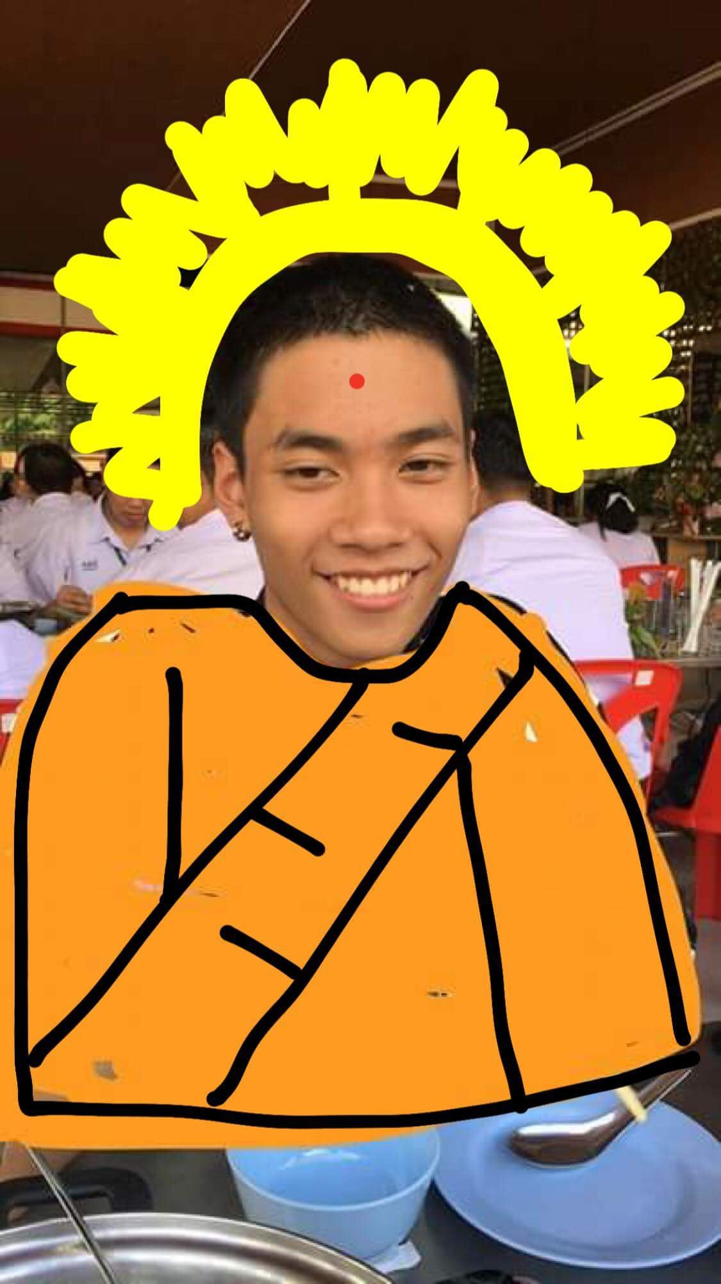
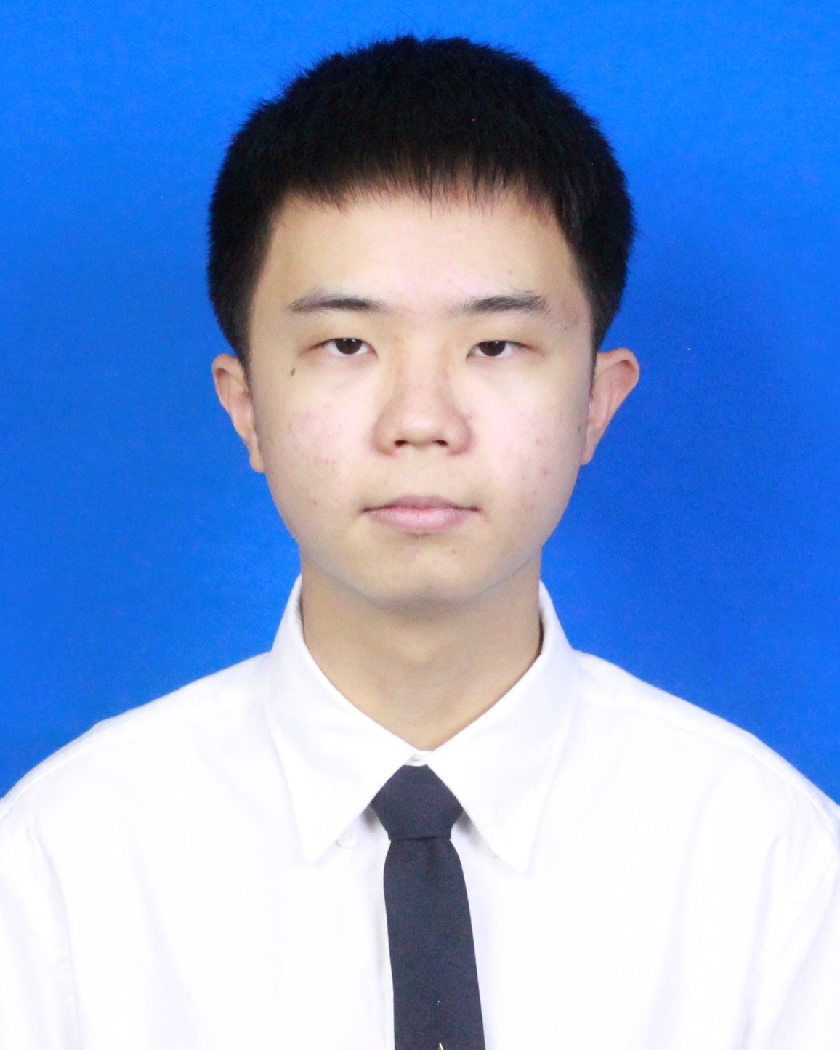



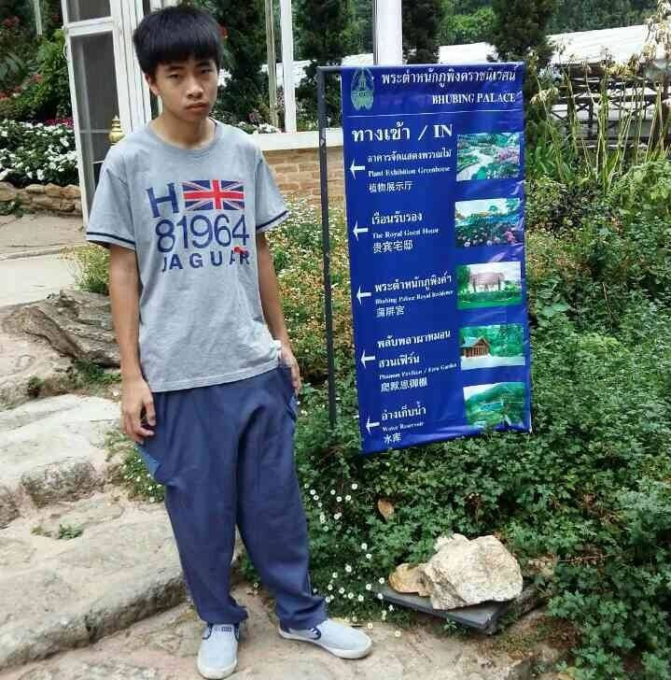
MEMBER
พัสกร ฉวีเนตร์ 1911310587
หาญชัย สุขเกษม 1911310785
วสุพล ลิขิตวิวัฒน์ 1911310561
ปฏิภาน ศักดิ์สมบูรณ์ 1911310595
อรรถกร เปี่ยมจริยกุล 1911310868

Slide 3

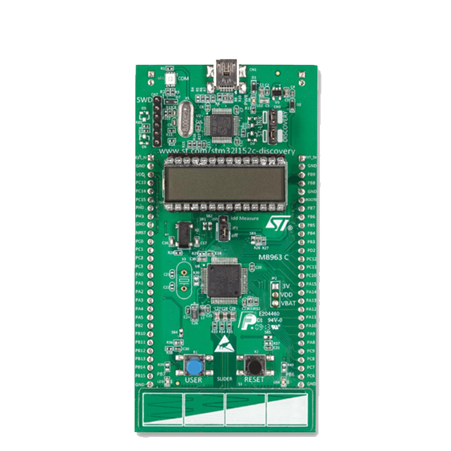


PROJECT DESIGN
Speaker
7-Segment
Temp

Slide 4

Specification
System information
MCU : STML32L152RB
Sensor Temperature
Software : keil/Language : C
Behavior
measure the temperature
Show Temperature ( 7-Segment)
- range : 4 digits
- unit Celsius
Sound(Speaker)
- Play note
Function
measure the temperature
Show Temperature ( 7-Segment)
Sound(Speaker)

Slide 5
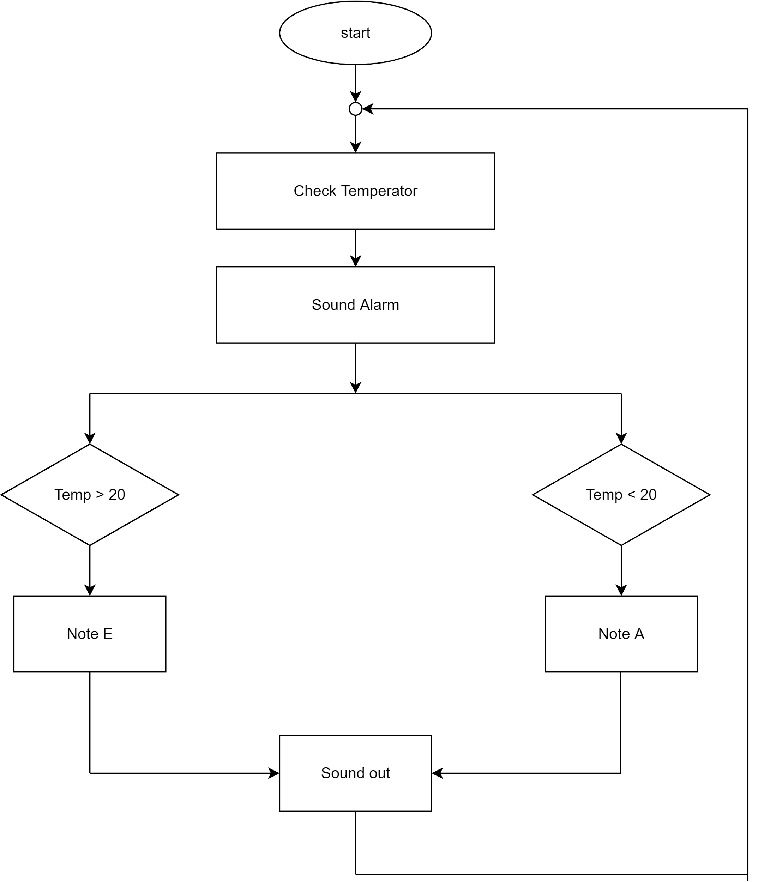
Detailed design

Slide 6
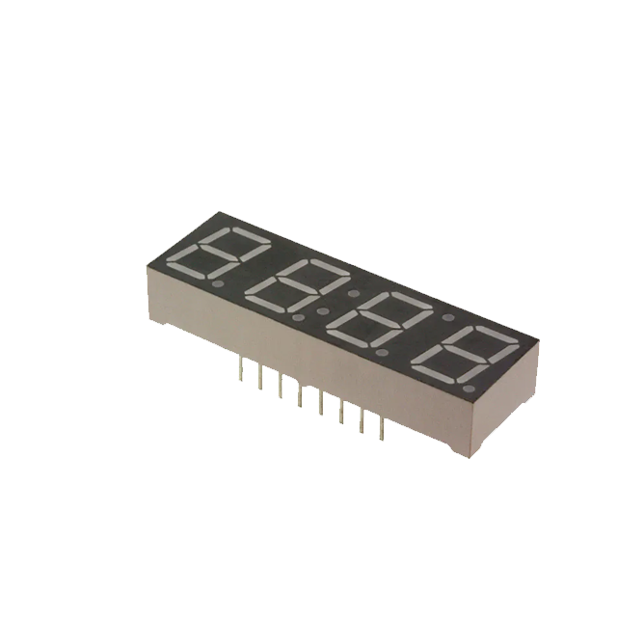
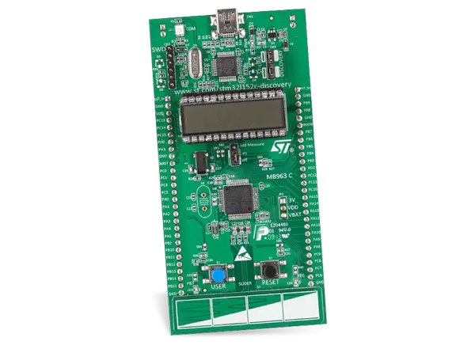
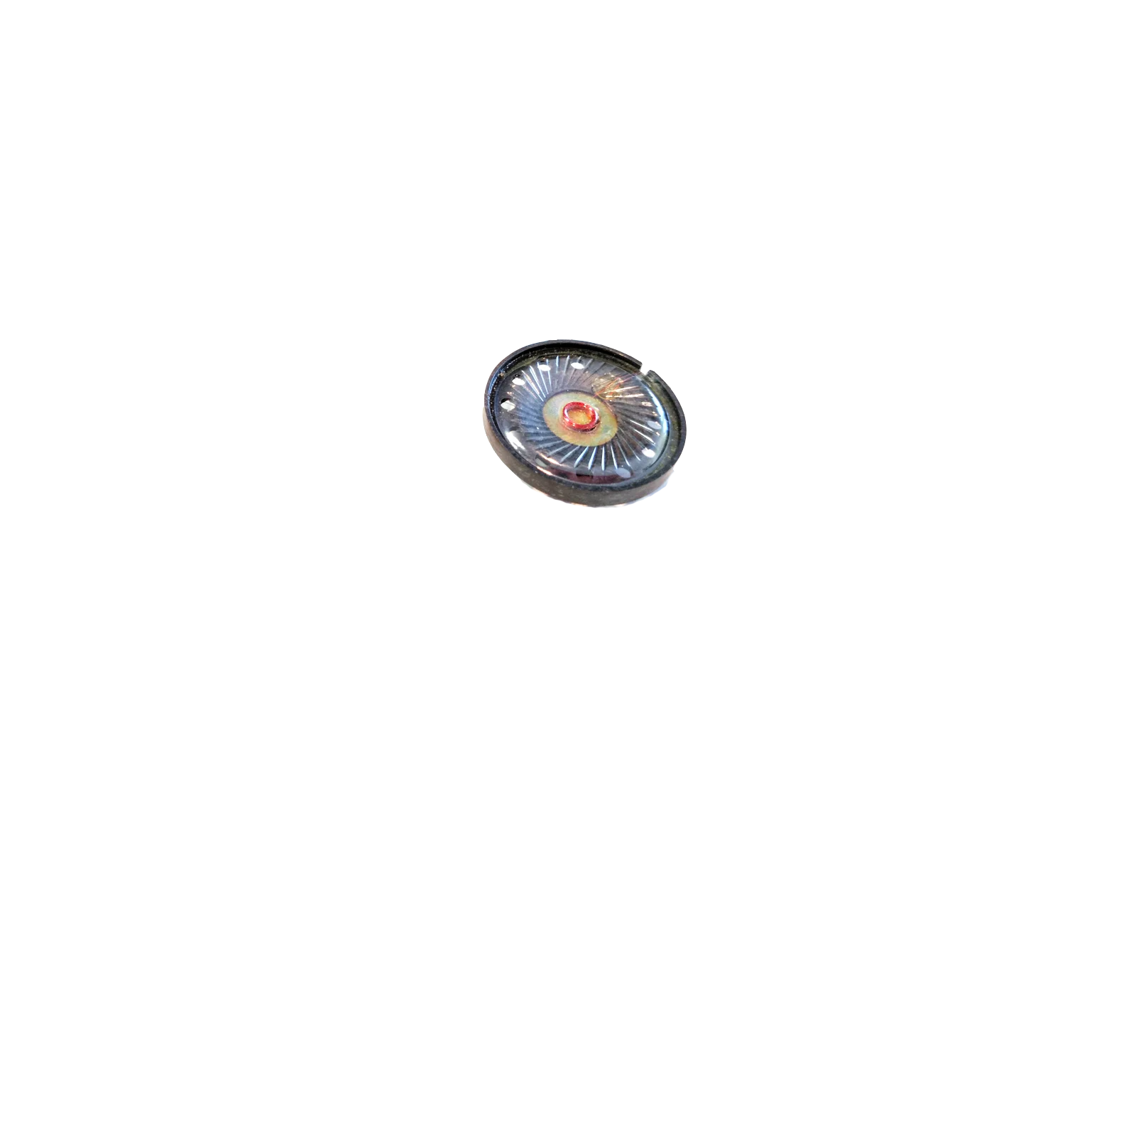
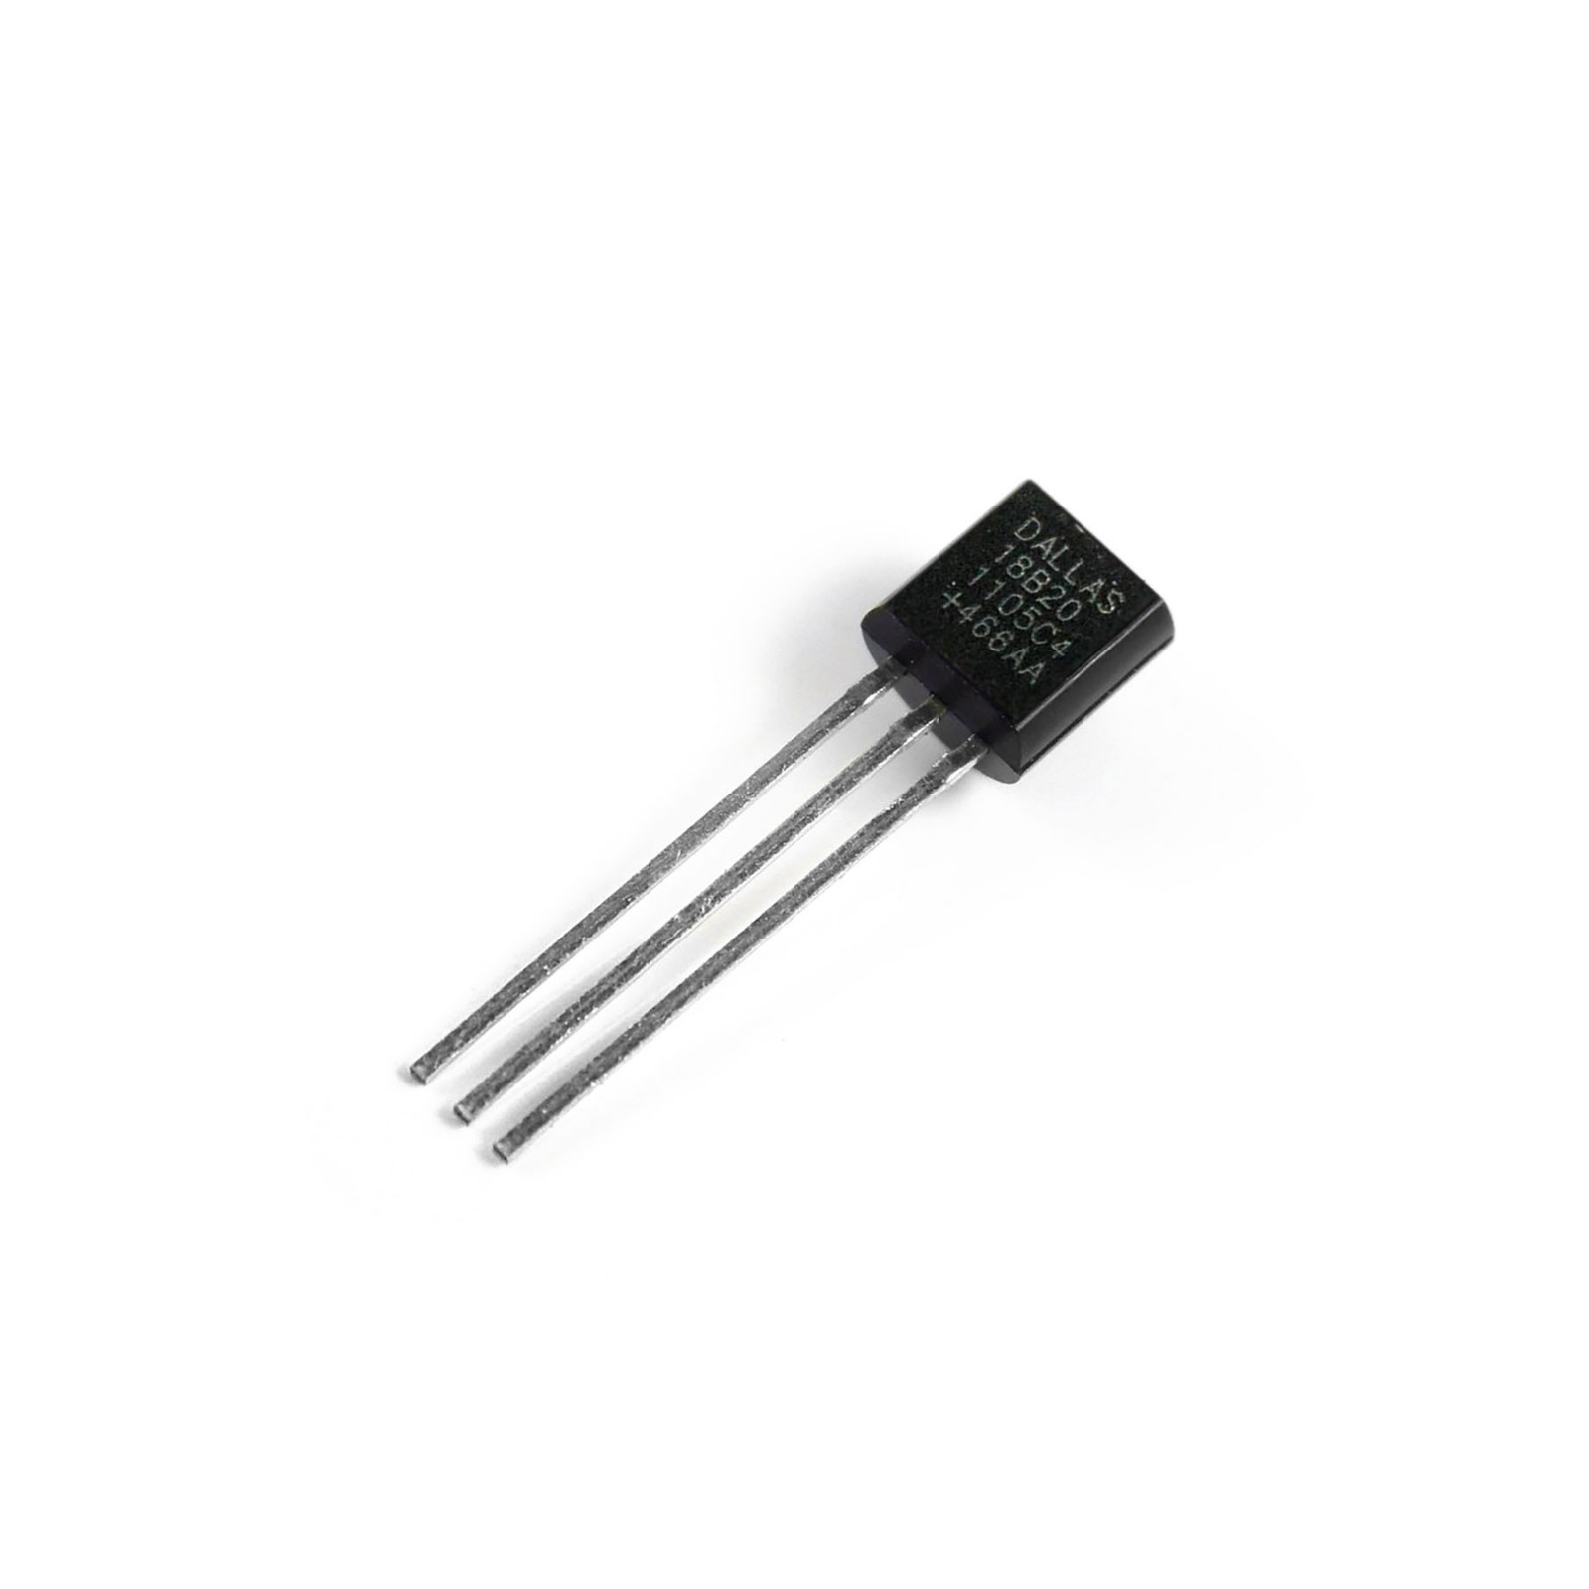
Hardware
STM 32L152C
7-segment LTC-4727JS
Temperature DS18B20
Speaker

Slide 7
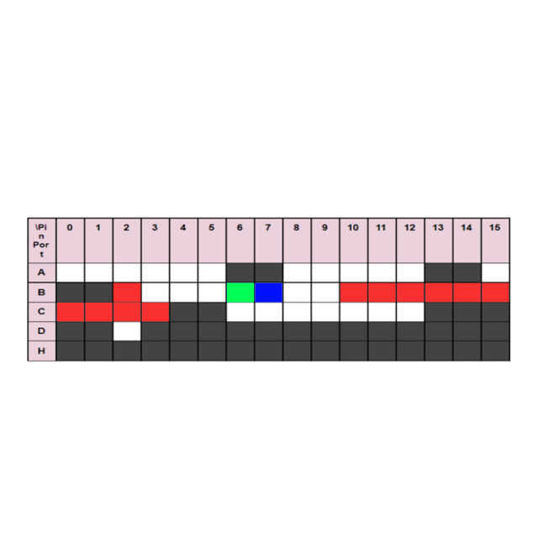
Board pin allocation
Speaker
Temperature Sensor
7 segment

Slide 8
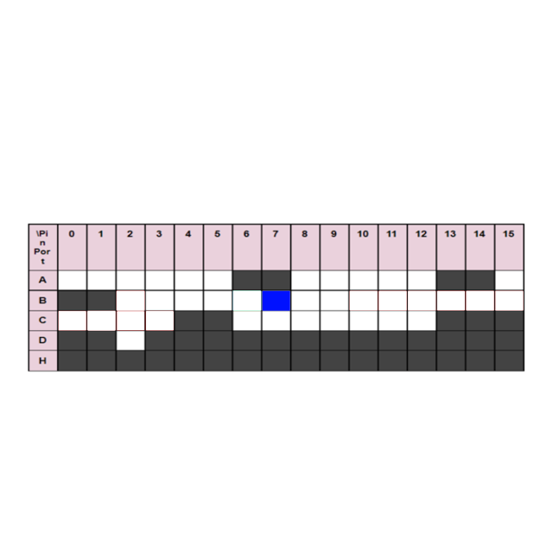
Temp DS18B20 Pin location
Temperature sensor pin

Slide 9
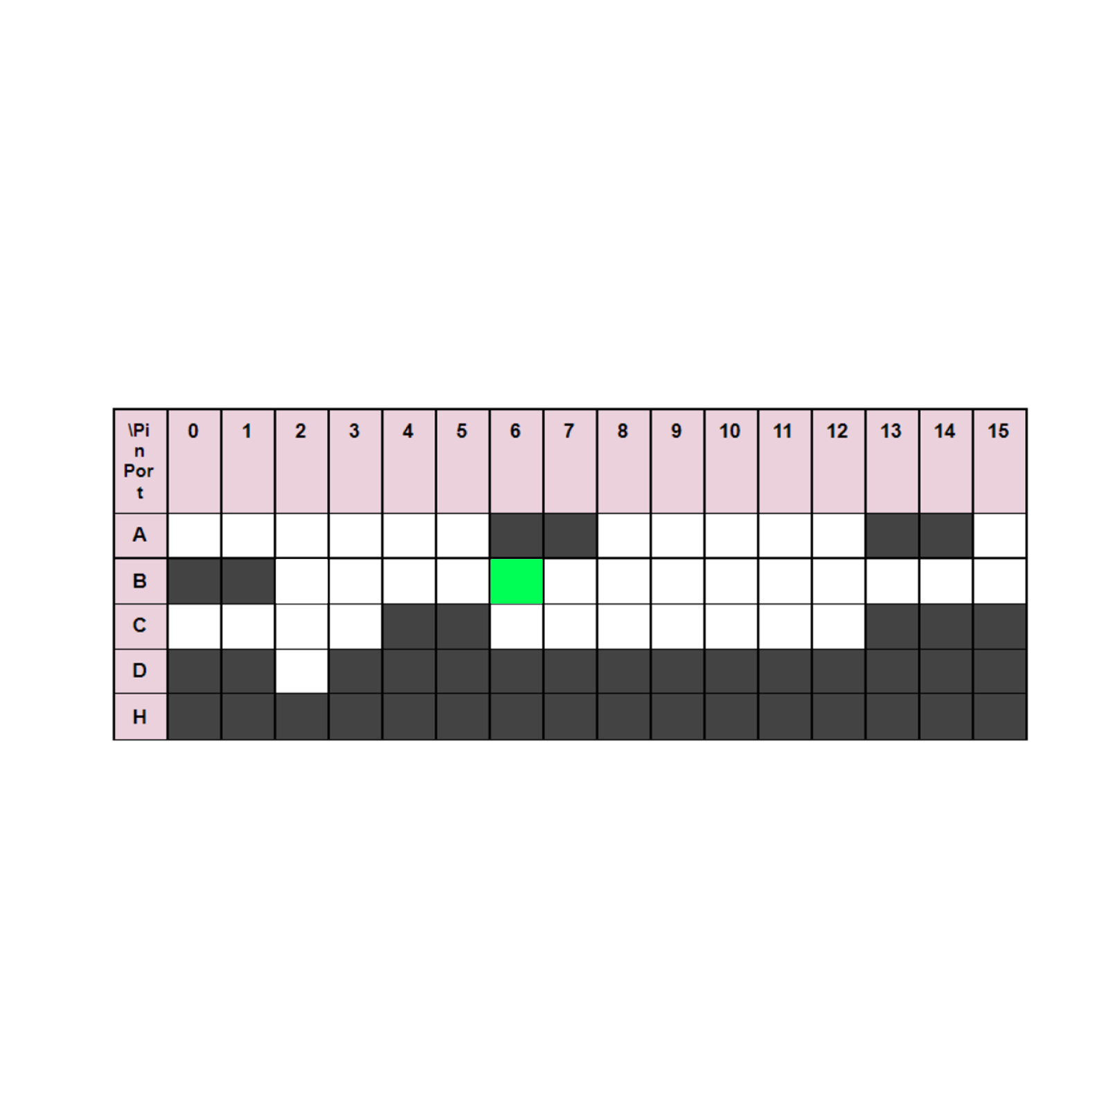
Speaker Pin location
Speaker

Slide 10
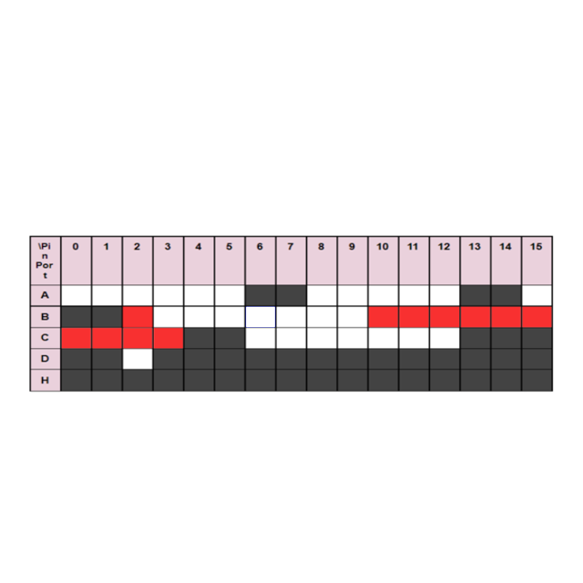
7-segment location
7-segment

Slide 11
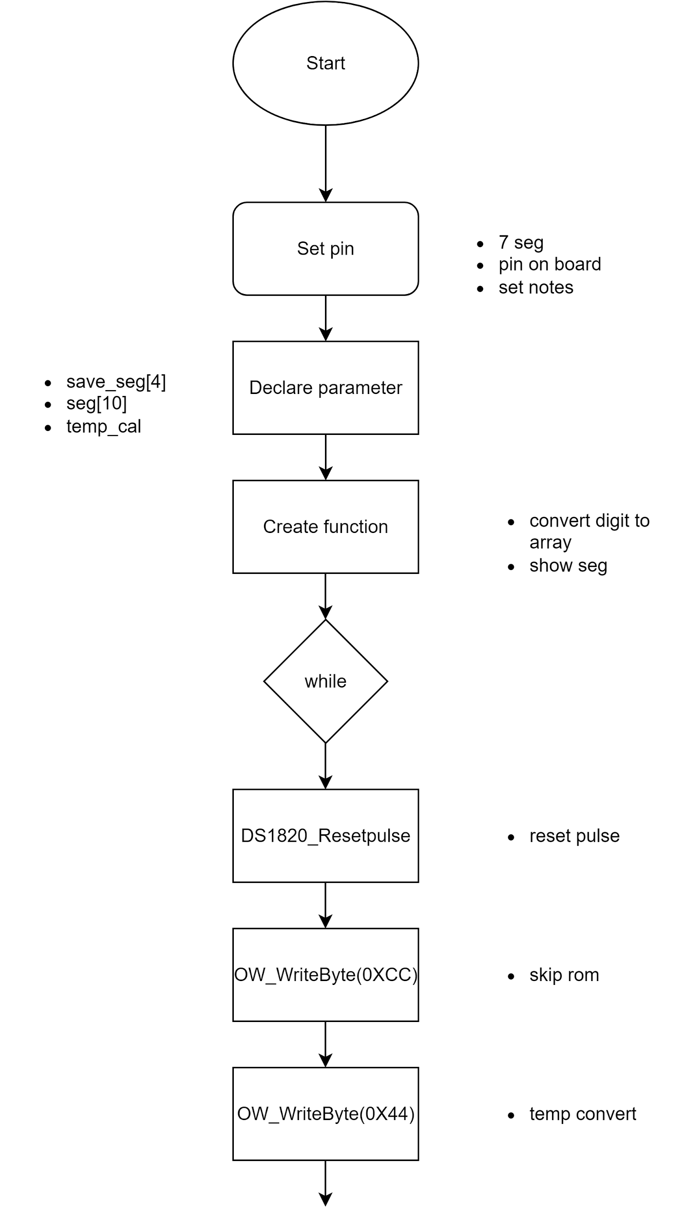
Coding flowchart

Slide 12
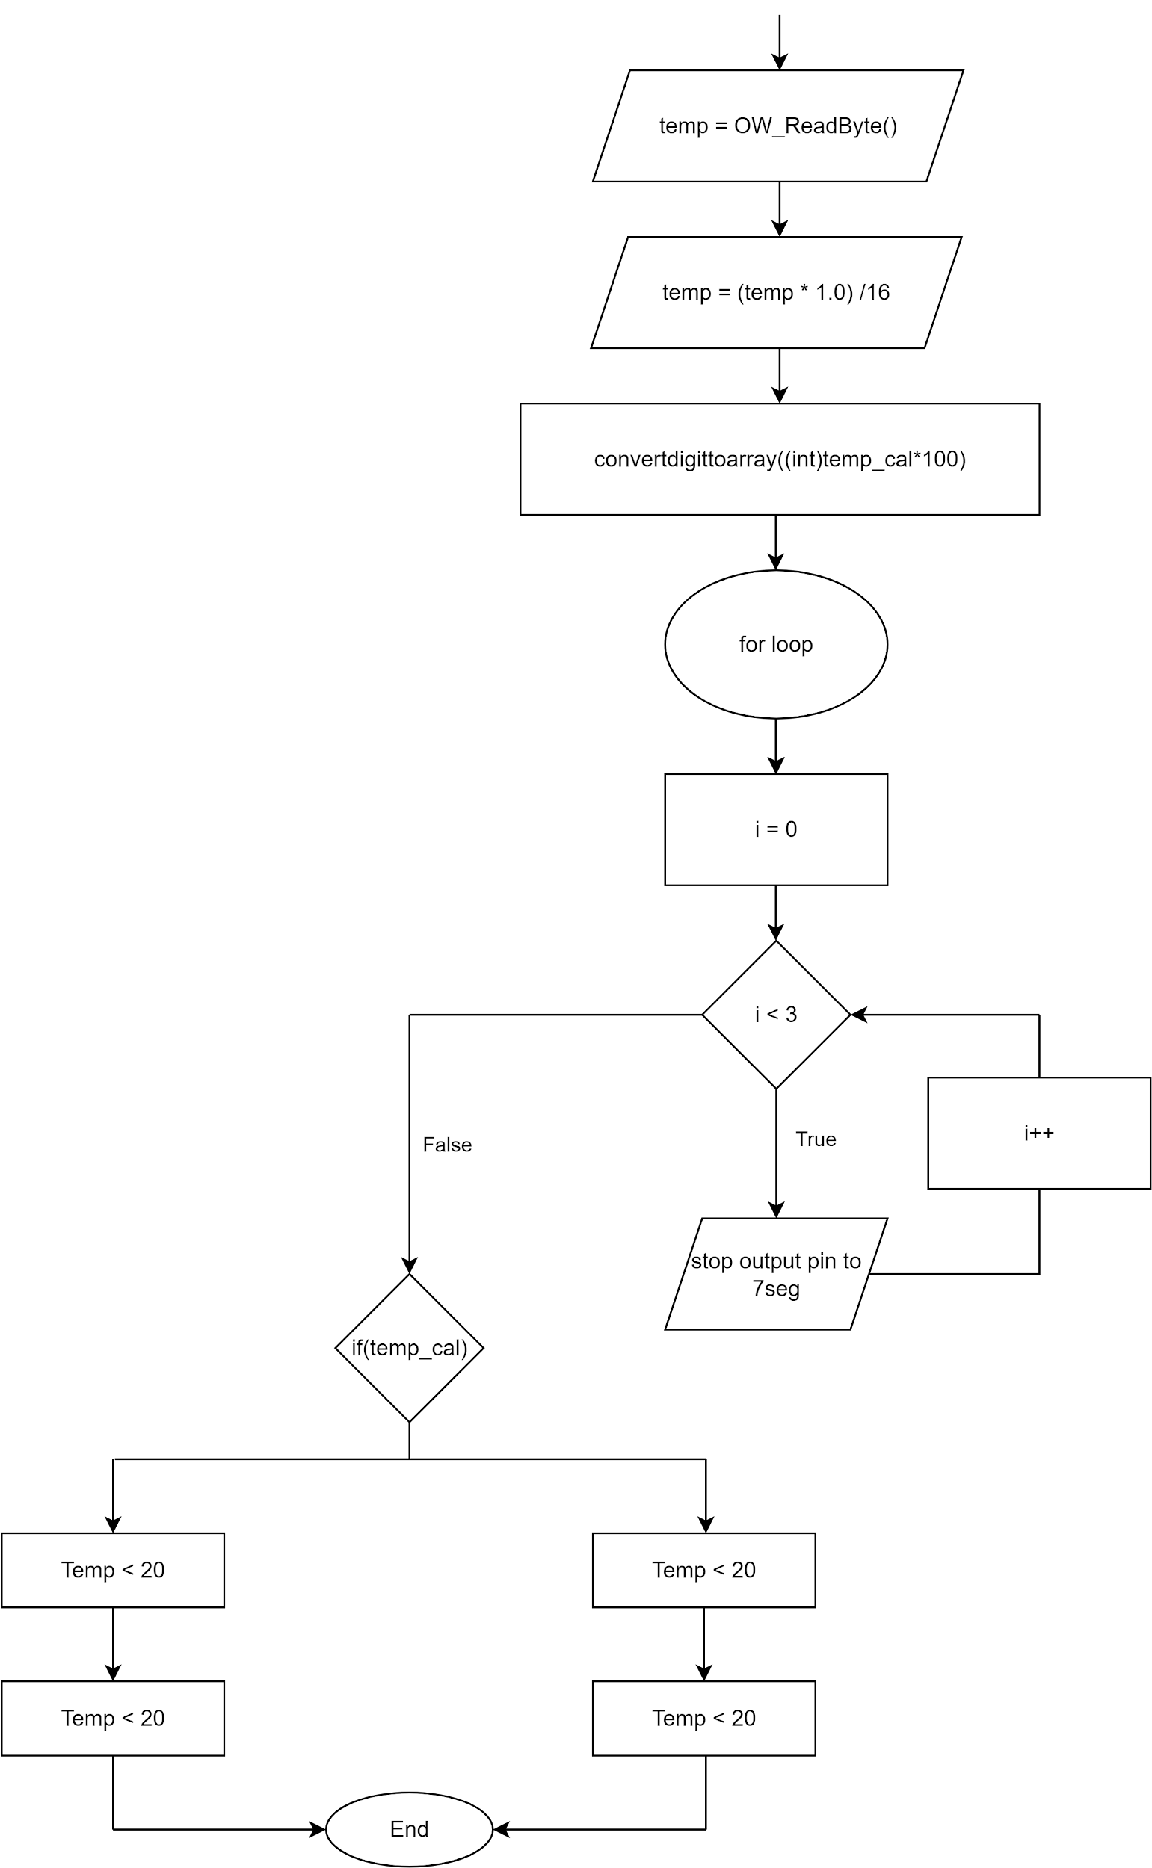
Coding flowchart

Slide 13
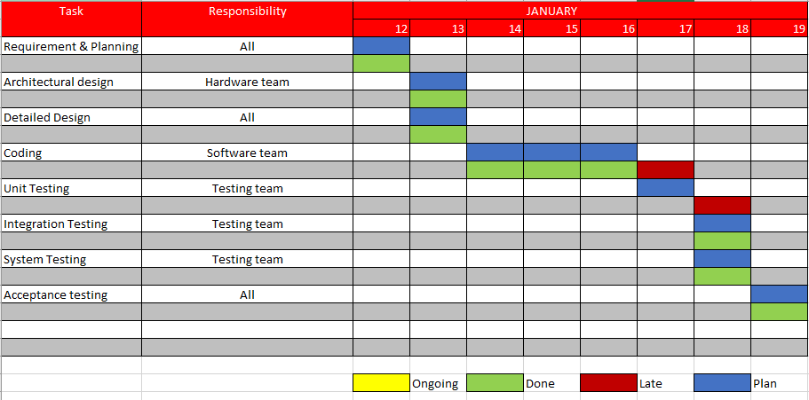
Gantt flowchart

Slide 14
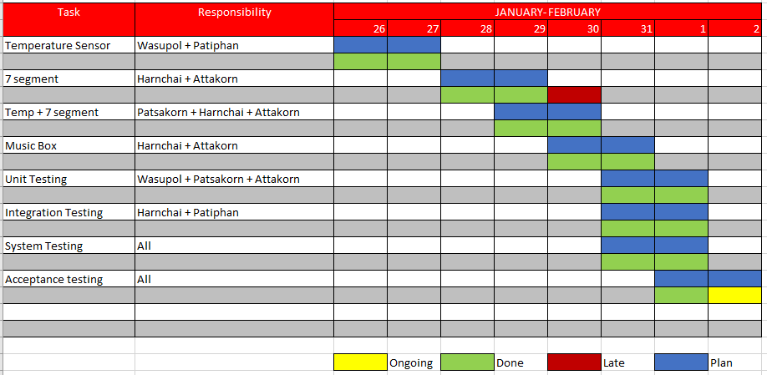
Gantt flowchart

Slide 15
Summarize : Model design
Requirement
Specification
Architecture Design
Detail Design
Coding
Unit Testing
Integration Testing
System Testing
Acceptance Testing

Slide 16


V I D E O

Slide 17
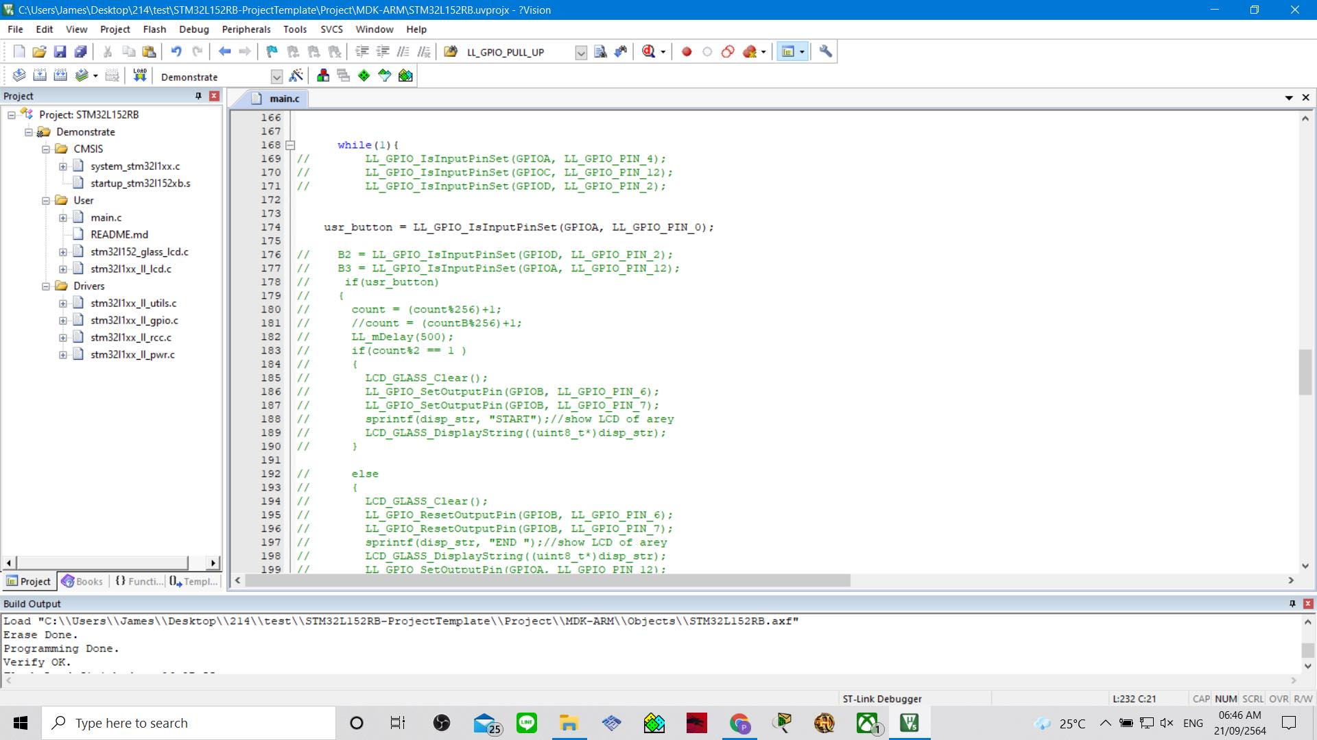

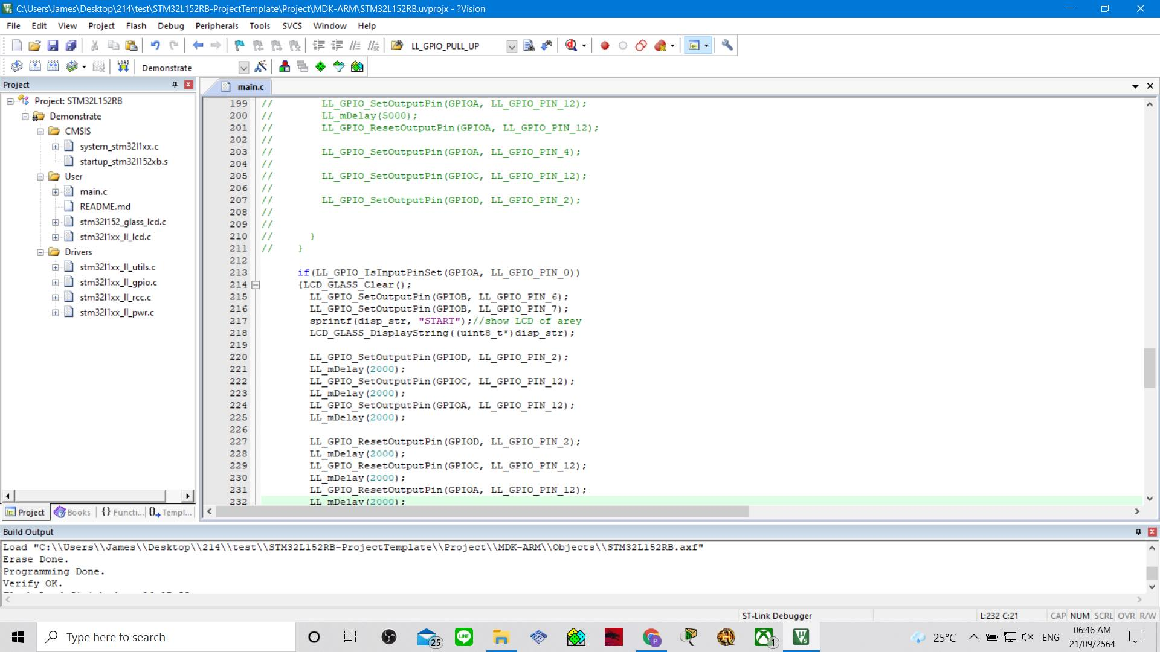
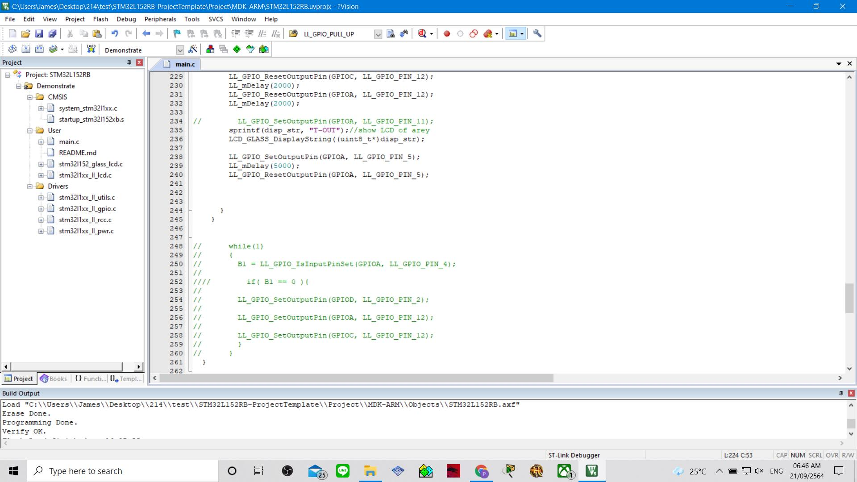
Problem/Solution

Slide 18




Thank
you

